Slide 1
Computer Graphics Model and world
László Szécsi szecsi@iit.bme.hu
AIT

Slide 2
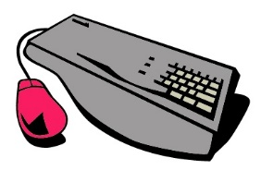
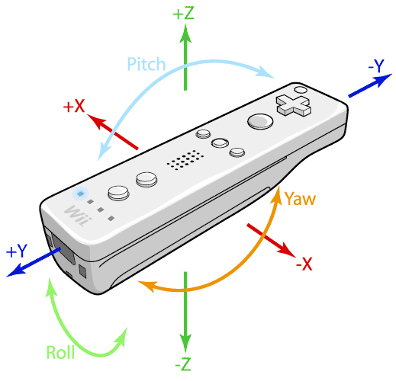



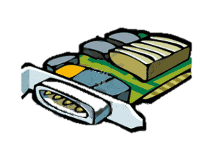

2D computer graphics
output pipeline
input pipeline
event handling
display
device
control
editing
animation
physical simulation
graphics
hardware
model
virtual world
numerical representation
rendering
modeling
analogy:
drawing shapes
on paper
Notes:
We have discussed the modeling process so far—at least to the point of specifying positions with coordinates. We revisited the mathematical machinery for transformations. Now it is time to talk about the rendering side. The virtual world model has been built, and we need to display it to the user.

Slide 3

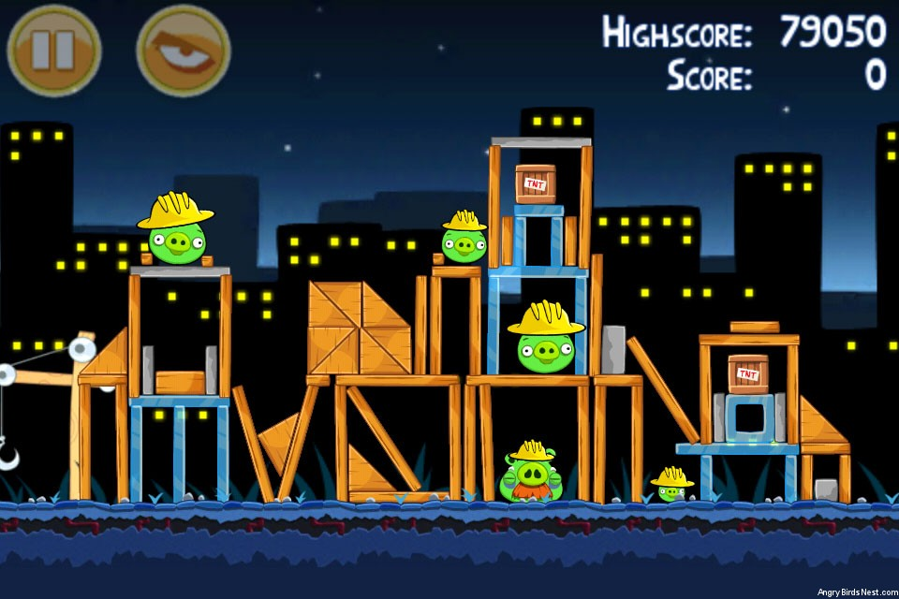
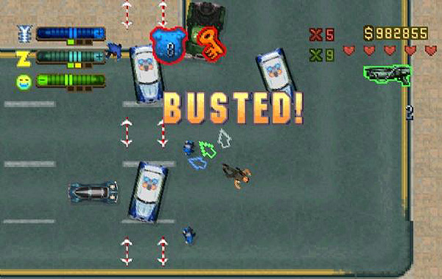
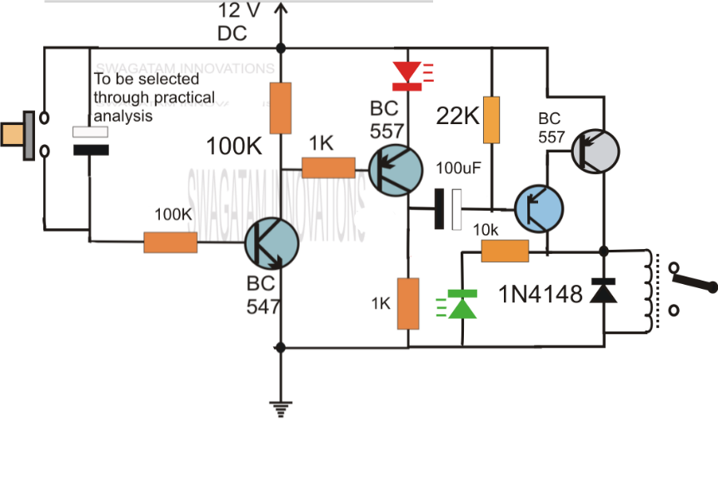
2D graphics systems
Notes:
Let us think about some examples of 2D graphics systems. Examples abound. Pretty much every piece of software that does have a visual interface and is not predominantly 3D can be seen as a 2D graphics system. Prezi, PowerPoint, or even Word? Yes. Adobe Reader? Absolutely. Adobe Illustrator? It is even a 2D editor!
Computer aided design (CAD) systems, integrated circuit planners, they are 2D graphics systems – not saying they might not include 3D, too.
And there are games. With online flash games, WebGL, and mobile apps, 2D graphics systems are omnipresent.

Slide 4
2D virtual worlds
The virtual world is a collection of objects
All objects have their own positions, orientations, or even scalings or shearings
But multiple objects may use the same model
may consist of geometry
curves, polygons, shapes
and texture
sprites
Notes:
A quite general way to look at virtual worlds is to see them as collections of objects (a.k.a. entities, or, in case of games, game objects). It is instantly obvious that some objects are similar, differing only in their poses (their positions and orientations, sometimes even their size). We can say that these objects share a common model, but have their own pose.
What makes a model? So we alluded to triangles meshes used as geometric models. But in our examples we saw that pre-drawn images are also used, and often look nicer then what polygons could achieve. These image elements are often called sprites.
Some graphics systems support copying pixel colors from generic memory to video memory (a fast process known as blitting), without free rotation or translation (the C64 computer of old even had dedicated sprite memory).
Today we use graphics libraries capable of rendering 3D geometry. Displaying images in OpenGL will be accomplished by applying those images onto polygons as textures. Free rotation and scaling, with appropriate resampling of the texture images to the pixels of the frame buffer, will be performed by the graphics system. Thus, we will focus on geometries, and mind texturing them later.

Slide 5
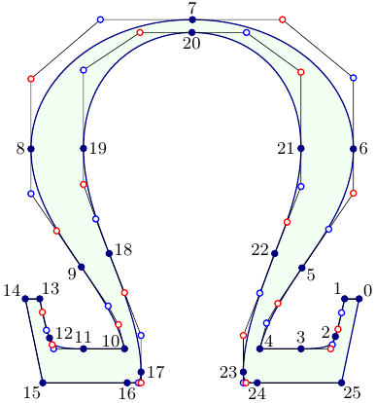


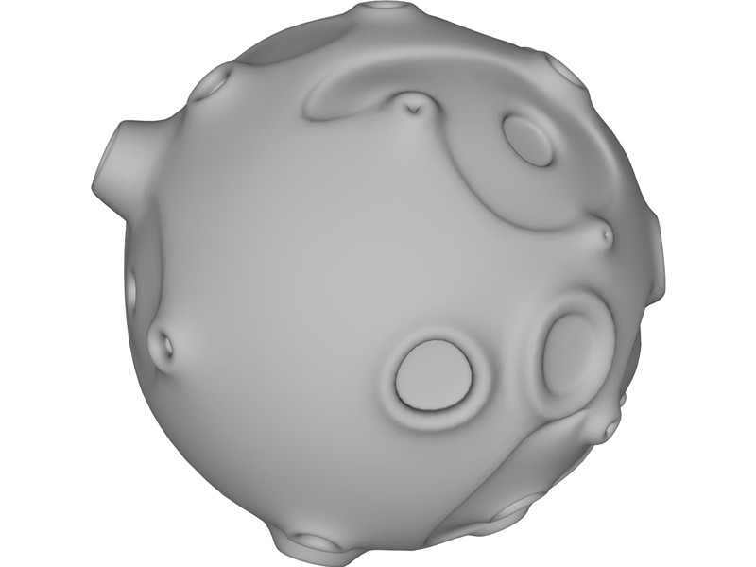
Models
Notes:
A model is a piece of geometry, an image, or the combination of the two. Geometry is specified through points, which needs a coordinate system. The coordinate space we define a model in is called the model space.
Models are usually too complex to be described by a single triangle, polygon, or curve. These basic constructs are referred to as primitives, and a model is a collection of primitives. Operations like draw, pick, etc. are mathematically defined for the primitives, and implementing them for the model means performing them for all the primitives.

Slide 6
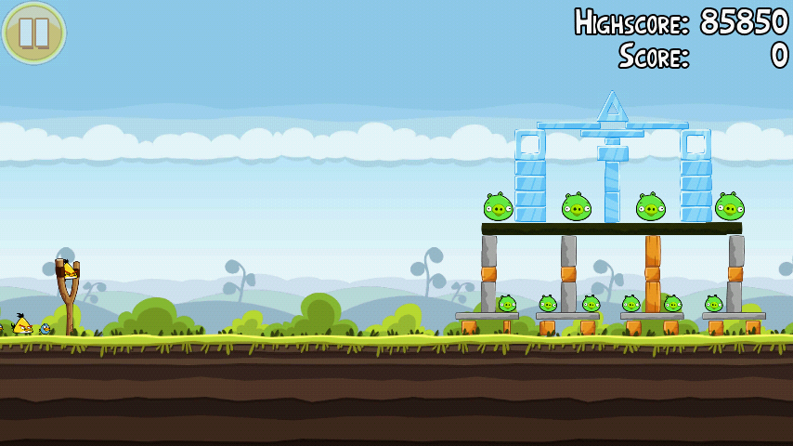
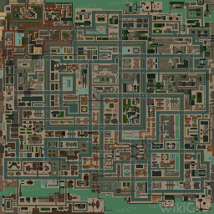
Worlds
Notes:
A 2D virtual world is composed of model instances, or objects. Where and in what pose those objects are must be given according to some reference system. This reference system is the world coordinate space.
There is one world space (for one 2D virtual world). We can draw the model coordinate axes for all the objects. This is easy to see as having multiple “object spaces”, using coordinates relative to the red coordinate axes. But note that there is no difference between the model space and the object space: the coordinates of the left ear of a pig w.r.t their own axes will be the same no matter which instance of the same model we consider.
Thus we could say that objects (a.k.a. model instances) define the mapping between model space and world space --- as they have their own positions and orientations. This mapping is unique for each object. The mapping will be described by a transformation, meaning all objects will have their own model transformation.
The terms object space and model space can be used synonymously.

Slide 7
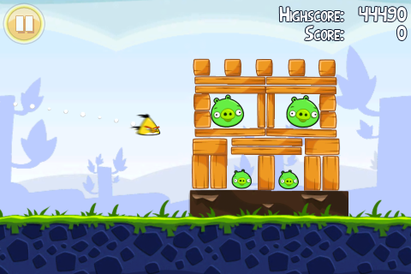
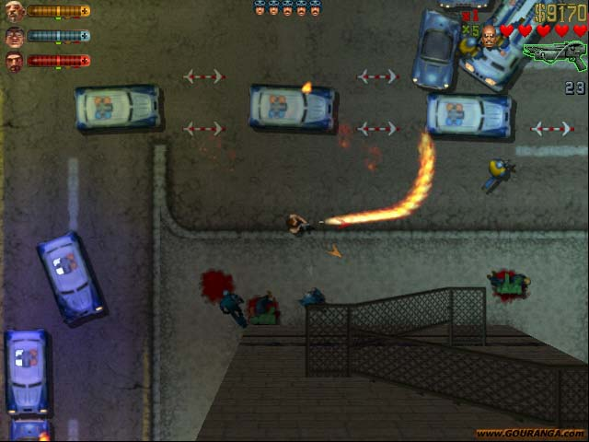
Visible window / 2D camera
Notes:
Not all of the virtual world is visible at a given time. We may pan the view, scroll the contents, zoom in or zoom out.
The part of the virtual world that is visible is called the window (not to be confused with the operating system window in which our viewport might be located). Because of the aforementioned panning and zooming capabilities, the window behaves quite like a real-life camera. The term '2D camera' is also applicable.
We can of course talk about position of points in the camera window. This is another coordinate space, and we can think of the camera as a mapping from world space coordinates to window space coordinates. Therefore, the 2D camera will be described by a transformation called the view transformation.

Slide 8
Transformations
Given the coordinates of a point in one space, what are its coordinates in another space?
static interpretation
What should I do with the original coordinates, to get them in another space?
dynamic interpretation
Notes:
Transformations are operations on points. The point is expressed by a set of coordinates. A transformation will yield a new set of coordinates. This can simultaneously be seen to:
a, calculate coordinates for the same point in a different space (this I will call the static interpretation)
b, change the coordinates of the point, moving it (the dynamic interpretation).
Both interpretations are valid. The static one tells us what the purpose of the computation is, the dynamic often helps us in its construction.
Transformations are a way to compute answers to questions we will be encountering in graphics, and incremental image synthesis in particular. Questions like:
If the modeler has drawn this vertex here, and the object is standing here, where in the world is the vertex?
If the triangle was modeled here, where should we draw it on screen?

Slide 9
The 2D image synthesis problem
given a 2D model
triangle vertices [model coordinates]
a 2D triangle drawing algorithm
colors pixels [viewport coordinates]
The task:
from the model coordinates of the vertex, compute in which pixel it appears
Notes:
Graphics libraries (like WebGL or OpenGL) or graphics hardware just draws points, line segments, and triangles on-screen. The task really is, given the models in the reference model spaces, where to draw those triangles on-screen, what pixels to color.
For a single triangle vertex point, this means a long journey of computations (transformations!) to find out where it actually appears on the display device.
Also, the transformations must take triangles and yield triangles. The class of transformations which has this property is called the class of homogeneous linear transformations. As they are linear, they can be written as a multiplication with a matrix. It is a 4x4 matrix, as it works on homogeneous coordinate quadruplets.

Slide 10
What would influence this?
Where our model is placed in the virtual world
model transformation, a.k.a. (world transformation)
Where the camera is, how zoomed-in it is
view transformation
How large pixels are
viewport transformation
To Be Addressed
Later
Notes:
What are the parameters of such a computation? What influences where a vertex ends up on the screen?
Where our model is placed in the virtual world.
This is defined by the model transformation parameters, a.k.a. (world transformation).
Where the camera is, how zoomed-in it is.
Defined by the camera parameters. The computation using these is the camera transformation.
How large pixels are
Handled by the viewport transformation.

Slide 11
Model and world coordinates (static interpretation)
model
world
Notes:
Recall that the virtual world contains model instances in different poses. The model transformation computes the world space coordinates of a model vertex for an object in a certain pose.
This interpretation tells us what we want to compute, but how the pose should be specified is not intuitive.

Slide 12
Model and world coordinates (dynamic interpretation)
Notes:
We can see this computation to move the model from its original reference position and orientation to its proper world pose. The transformation can be constructed a rotation for the orientation, and a translation for the position.
So, performing a rotation and a translation will compute world space coordinates from model space coordinates. The transformation can be said to take the model from model space to world space. This interpretation is useful for the construction of the model transform.

Slide 13
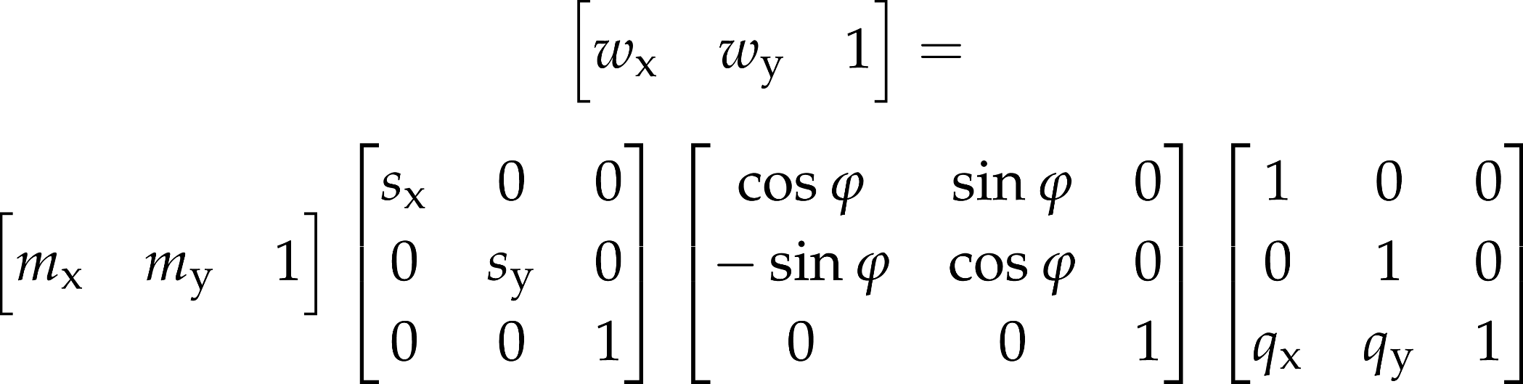
Constructing a model transformation
from
vertex
buffer
Notes:
When we are placing the object in the virtual world, we often want to think about this in human-interpretable terms. The notions of size, orientation and position are straightforward. A model matrix for such a pose can be constructed as a concatenation of a scaling, a rotation, and a translation.
As scaling and rotation are wrt. the origin and the coordinate axes, the order of transformations is important. If we first rotate then scale, then the object will be not be scaled along its model space axes. If we first translate, then rotate, then the object will not be rotated in place, but it will orbit the origin.

Slide 14
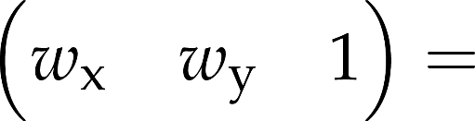
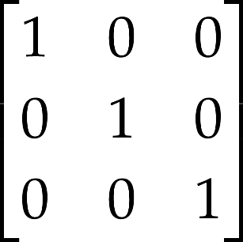
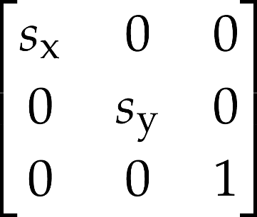
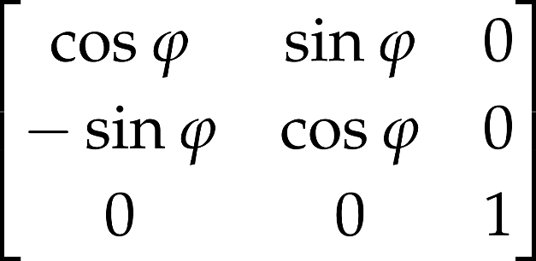
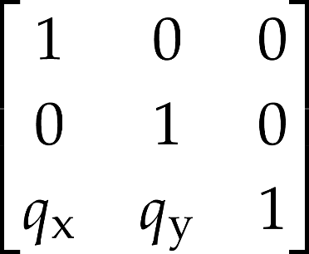
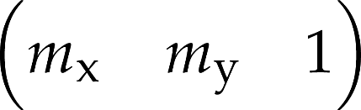
Constructing a model transformation
from vertex buffer
new Mat4()
.scale(sx, sy)
.rotate(phi)
.translate(qx, qy)
compose matrix on host
vector-matrix multiplication happens in the shader

